Slide 1
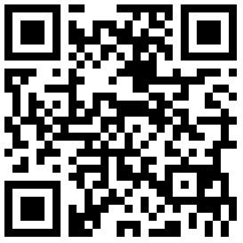
16th International Symposium on Integral Car Safety Systems – November 25-27, 2024
International Young Talents
—
Call for Applications
Are you interested in learning more about how the transformation towards electrification and autonomous driving will influence the development of passive safety systems within the automotive industry?
Are you interested in getting to know with experts from leading companies within the passive safety industry?
Are you considering starting a professional career in enhancing safety for the mobility of the future?
»
»
»
Organized by
#airbagsymposium
#Airbag2024
www.airbag-symposium.eu/YoungTalents
Then you might be interested in our International Young Talent Program!

Slide 2
Upon invitation we will offer:
Free admission to the 16th International Symposium on Integral Car Safety Systems and the accompanying exhibition, including an exclusive guided tour of exhibition to meet, network and exchange information with the key players within the passive safety business.
The opportunity to meet with HR departments of leading companies from global markets to discuss internship, thesis and job opportunities.
Who is the target group?
Students and young professionals interested in joining the R&D community for passive safety systems, to exchange information with leading experts on a professional level, and to take their career a step further by exploring internship, thesis and job opportunities within this exciting and rapidly growing field.
16th International Symposium on Integral Car Safety Systems – November 25-27, 2024
What we are asking from you
Please take your time to tell us about yourself, your motivation and why you are the right candidate for one of the limited slots in our International Young Talent Program.
Please upload you curriculum vitae and your letter of motivation by the 30th of June 2024 online: www.airbag-symposium.eu
Organized by
#airbagsymposium
#Airbag2024
www.airbag-symposium.eu/YoungTalents

